Slide 1

Semester Project Final Presentation
Automated propeller geometry measurement
from 3d scanning data
LIS
Supervisors :
D. Floreano
S. Steffen
A. Bhaskaran
Author:
P. Maury Laribière
Notes:
Automation propeller geometry measurement
From 3D scanning data

Slide 2
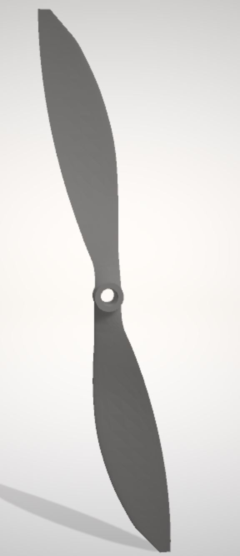
Summary :
Introduction
Initial concepts
Goal of the project
State of art
Methodology
Aerofoil shape
Parameters
Discussion
Conclusion
Fig.1: Propeller STL file
Notes:
First, introduce. Give prior info to understand following
Then, Methodology: done until now, and what is left to do

Slide 3
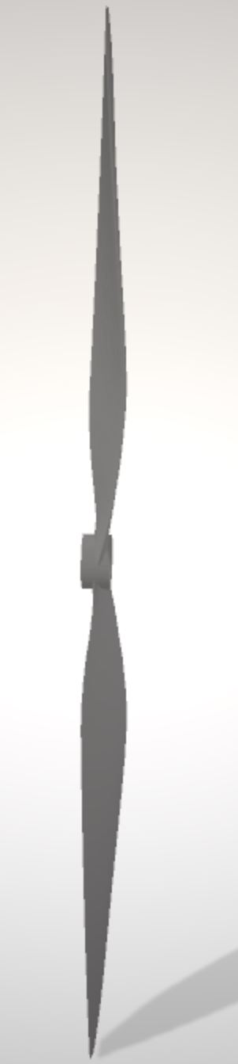
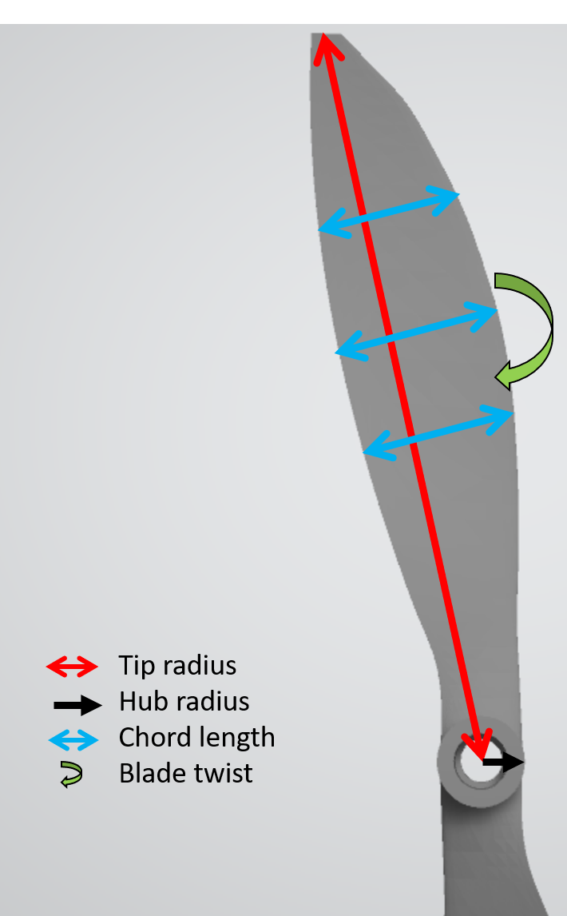
Introduction: Initial concepts
Geometric parameters of the blade
Aerofoil
Chord length
Tip radius
Hub radius
Blade twist
Aerofoil
cross-section
Notes:
Project with propellers.
Explain main terms will use for parameters
Aerofoil = cross sectionnal shape of blade

Slide 4
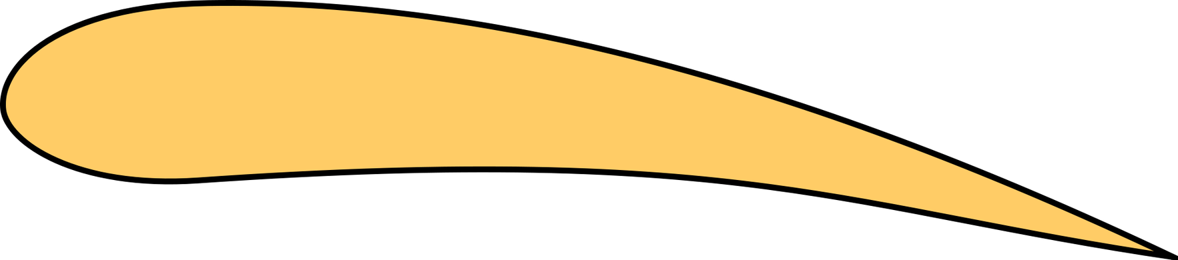
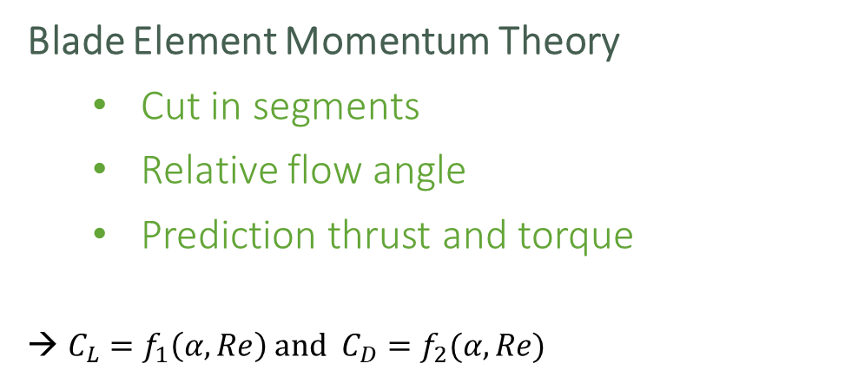
Introduction: Initial concepts
Blade Element Momentum Theory
Cut in segments
Relative flow angle
Prediction thrust and torque
${C_{L}=f}_{1}\left(α, Re\right)$ and ${C_{D}=f}_{2}(α, Re)$
Air velocity
α = β - φ
β
φ
Rotation
Notes:
Nowadays drone perf analysis: BEMT.
cuts the propeller down into discrete segments along the radius
Estimate relative flow angle to blade segment WITH law conservation of momentum
→ Predict thrust and torques generated by segment (integrate over radius for all propeller)
→ Aerodynamic effect of the air flow on propeller performance -- lift and drag normal and parallel to prop
Method to predict performance of drone based on shape of propeller
Axial component of this hydrodynamic force = element thrust
Moment about the propeller axis of the tangential component = element torque.
Resultant velocity:
-include an axial velocity V0
-a rotational velocity V2 which varies up to the blade tip.
Propeller blade will be set at a given geometric pitch angle (alpha),
Local velocity vector will create a flow angle of attack on the section.
The lift and drag of the section can be calculated using standard 2D hydrofoil properties.
The lift and drag components normal to and parallel to the propeller disk can be calculated so that the contribution to the thrust and torque of the complete propeller from this single element can be found.

Slide 5
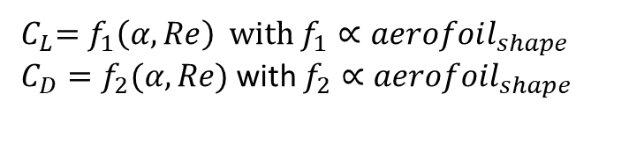
Introduction: Initial concepts
Air velocity
${{ C}_{L}=f}_{1}\left(α, Re\right)$ with $f_{1}∝aerofoil_{shape}$ ${C_{D}=f}_{2}(α, Re)$with $f_{2}∝aerofoil_{shape}$
α = β - φ
β
φ
Rotation
Notes:
Nowadays drone perf analysis: BEMT.
cuts the propeller down into discrete segments along the radius
Estimate relative flow angle to blade segment WITH law conservation of momentum
→ Predict thrust and torques generated by segment (integrate over radius for all propeller)
→ Aerodynamic effect of the air flow on propeller performance -- lift and drag normal and parallel to prop
Method to predict performance of drone based on shape of propeller
Axial component of this hydrodynamic force = element thrust
Moment about the propeller axis of the tangential component = element torque.
Resultant velocity:
-include an axial velocity V0
-a rotational velocity V2 which varies up to the blade tip.
Propeller blade will be set at a given geometric pitch angle (alpha),
Local velocity vector will create a flow angle of attack on the section.
The lift and drag of the section can be calculated using standard 2D hydrofoil properties.
The lift and drag components normal to and parallel to the propeller disk can be calculated so that the contribution to the thrust and torque of the complete propeller from this single element can be found.

Slide 6

Introduction: Goal of the Project
Goal :
Performance
Blade Element Momentum theory
Shape
Problem :
Shape is not given
3D scanning
Fig.4: Point cloud of propeller
Notes:
GOAL: create a tool to analyze performance of drone
Usually drone analysis with:
1. Wind tunnels (not practical)
2. BEMT (need shape) → not easily available. Not published by manufacturers
NEED: propeller shape to understand performance of drone
IDEA:
3D scan propeller → obtain point cloud of its surface → compute parameters and aerofoil shape on based → enable to use BEMT

Slide 7
Introduction: State of the art
Choices for 3D Scanning:
1. Contact
2. Non Contact Active
3. Non Contact Passive
CMM
[1]
Structured Light
[2]
Time of flight
[2]
Laser triangulation [2]
Photogrammetry
[3]
5 main techniques
Notes:
Need a scanning method to generate point cloud. 5 main techniques to choose from
Contact : CMM: probe physically touches a firmly fixed object at several points and samples the different positions of the surface
Non contact active ----- rely on the emission of radiation or light.
Structured Light: a pattern of light. Measuring deformation of pattern on the object: shape deduced
Time of flight: Laser beam projected onto surface. Collected by a sensor. ToF of laser beam between its emission and reception provides geometrical information
Laser triangulation: Depending on distance object, reflected light falls at angle on receiving element. Determining spot position, distance object-receiver computed
3. Non CP: Photogrammetry: reconstructs a 3D model object from 2D digital pictures taken at different angles (computer vision + computational geometry algo)

Slide 8
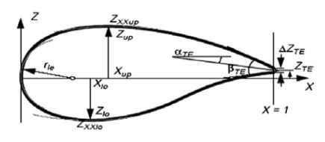
Introduction: State of the art
Cross section (= aerofoil shape) parametrisation
Bézier [4]
Parsec [4]
Bésier – Parsec [4]
Sobieczky (with PARSEC) [5]
Improved Parameter Geometric [6]
Exemple : Parsec parametrisation
Fig 5: PARSEC parametrisation parameters [4]
Notes:
Once scanning data, need to know how to parametrize aerofoil
Aerofoil = cross section
Many techniques which uses different features
Bezier: polynomials curves
Parsec parameters -- improved
Less parameters: IPG
Will try which is best to describe aerofoil obtained from point cloud

Slide 9
Methodology : Algorithm
Step 1:
Pre-processing
STL to CSV
Principal directions
Step 2:
Points selection
Step 3:
Side assignment
Step 4 :
Curves interpolation
Step 5:
Parameters computation
Step 6:
Xfoil
Point output for Xfoil
Reynold and Mach
Notes:
6 main steps overview

Slide 10
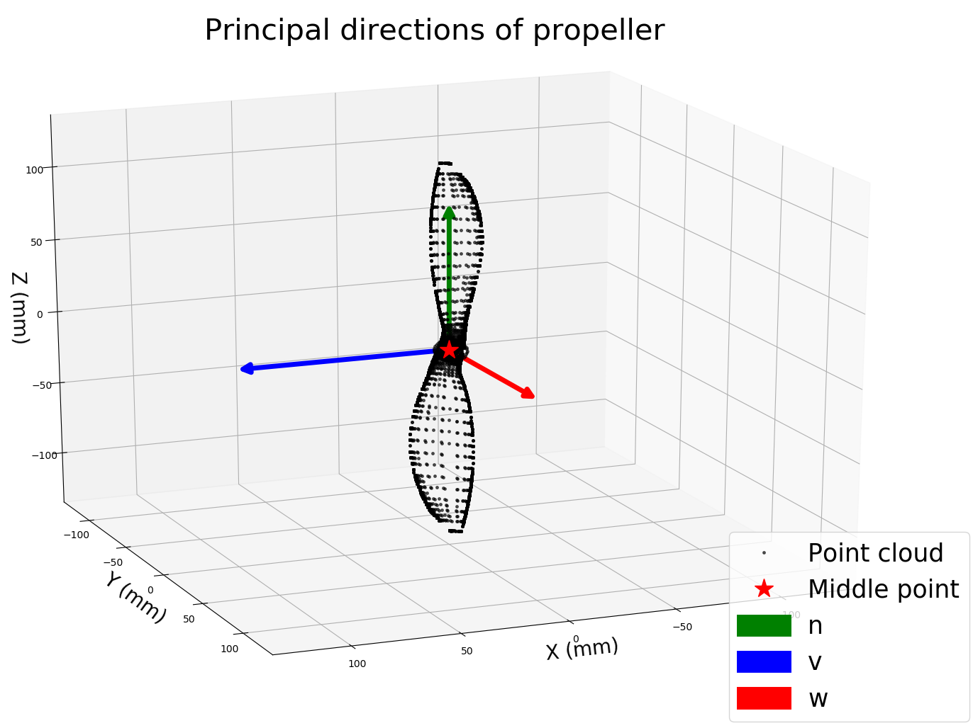
Methodology : Algorithm
Step 1: pre-processing
STL to CSV
Principal direction
Centering and rotating
Fig.6: Main directions

Slide 11
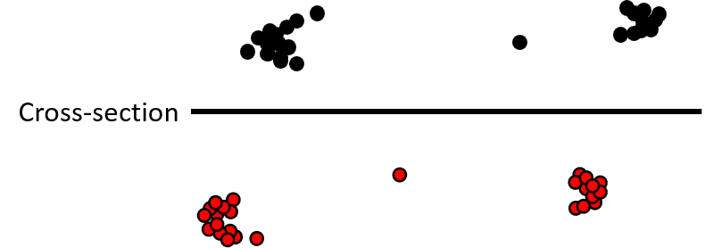
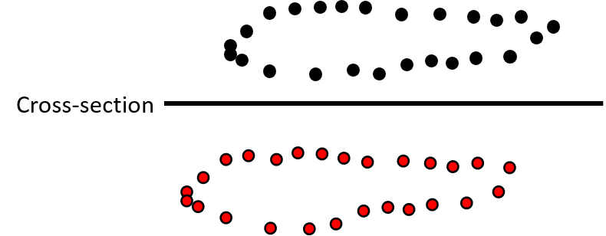

Methodology : Algorithm
Reality
Δ
Step 2: Points selection
Iterative algorithm
Accuracy change
Goal
$$w_{min}=\frac{chord}{40}$$

Slide 12
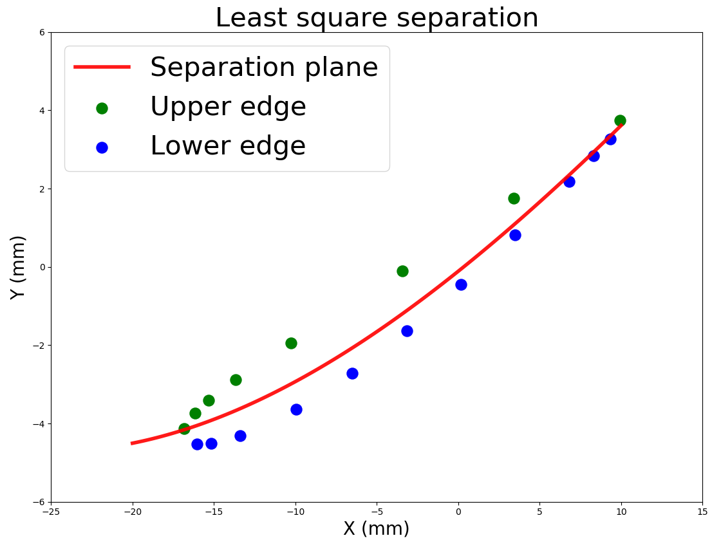
Methodology : Algorithm
Step 3: Side assignment
Least squares

Slide 13
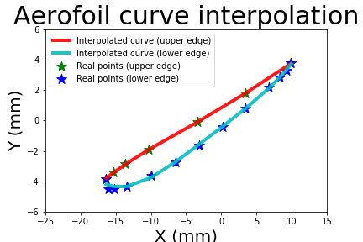
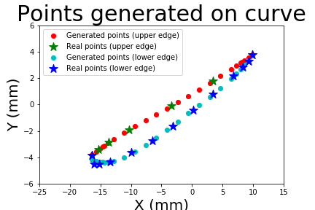
Methodology : Algorithm
Step 4: Curves interpolation (4th order polynomial)

Slide 14
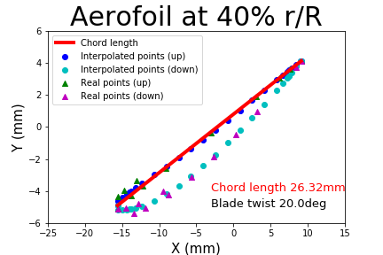
Methodology : Algorithm
Step 5: Parameters computation
Chord length
Blade twist

Slide 15
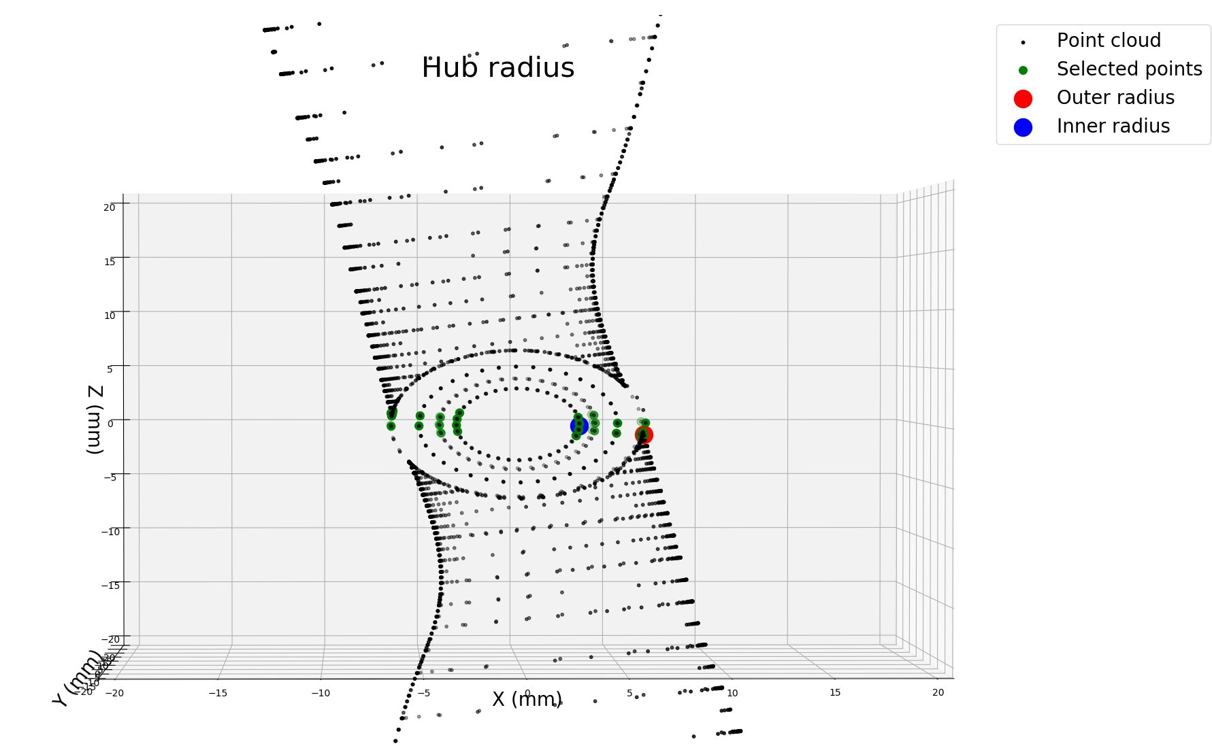
Methodology : Algorithm
Step 5: Parameters computation
Tip radius
Hub radius

Slide 16
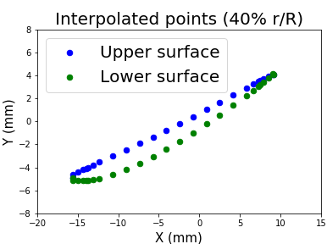
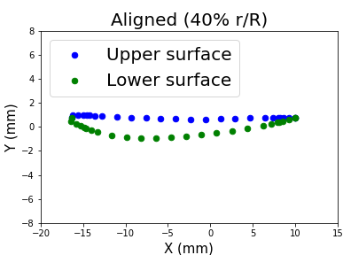
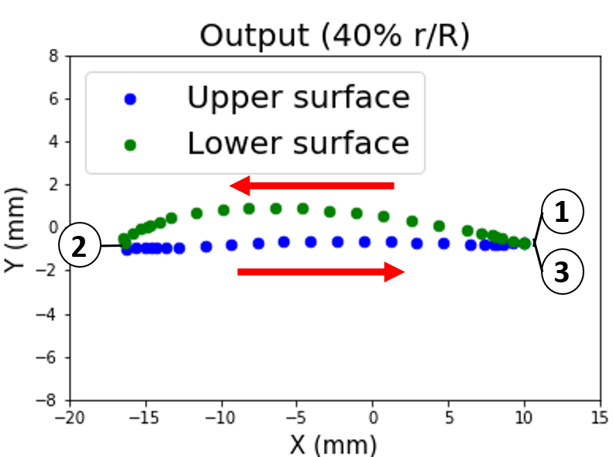
Methodology :
Step 6: X-Foil output
Align, mirror, (normalize), right order
Reynold and Mach

Slide 17
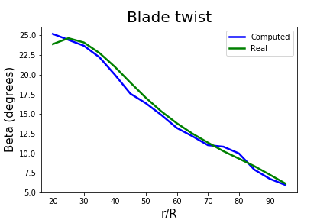
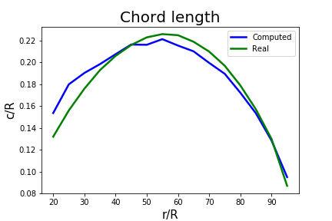
Results: Parameters
Chord length | Blade twist | Hub Radius | Tip Radius
RMSE 0.06 mm | RMSE 8.76 deg | Relative error | Relative error 0.19 mm
Notes:
To conclude,
Goal: compute interesting parameter and shape information of propeller from 3D scanning data to be able to use BEMT on it
Done.
Still projections
Then Xfoil and parameters
Optionnal: find processes to further automate the 3D scanning of the propeller using examples of tools available on the market

Slide 18
Results: X-Foil
No convergence in viscid mode
Could not compare with real parameters
Notes:
To conclude,
Goal: compute interesting parameter and shape information of propeller from 3D scanning data to be able to use BEMT on it
Done.
Still projections
Then Xfoil and parameters
Optionnal: find processes to further automate the 3D scanning of the propeller using examples of tools available on the market

Slide 19
Discussion
Function choice
X-Foil not converging: continuity of both curves (?)
Scanning method
STL format
Photogrammetry
Notes:
To conclude,
Goal: compute interesting parameter and shape information of propeller from 3D scanning data to be able to use BEMT on it
Done.
Still projections
Then Xfoil and parameters
Optionnal: find processes to further automate the 3D scanning of the propeller using examples of tools available on the market

Slide 20
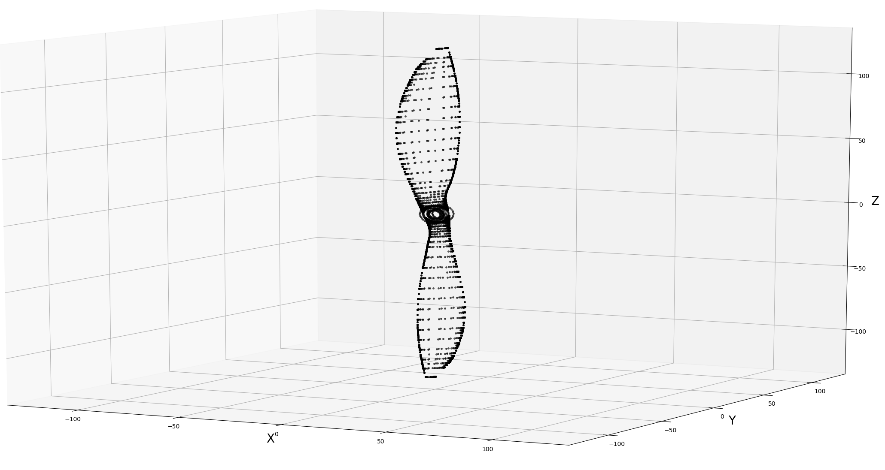
Conclusion
Reverse engineering algorithm
Propeller shape for drone performance analysis
Aerofoil shape
Parameters
Xfoil
Notes:
To conclude,
Goal: compute interesting parameter and shape information of propeller from 3D scanning data to be able to use BEMT on it
Done.
Still projections
Then Xfoil and parameters
Optionnal: find processes to further automate the 3D scanning of the propeller using examples of tools available on the market

Slide 21
Thank you for your attention

Slide 22
References
[1] A.W.L. Yao « Applications of 3D scanning and reverse engineering techniques for quality control of quick response products» Received: 2 October 2003 / Accepted: 27 January 2004 / Published online: 16 June 2004 © Springer-Verlag London Limited 2004
[2] Morteza Daneshmand, Ahmed Helmi, Egils Avots, Fatemeh Noroozi, Fatih Alisinanoglu, Hasan Sait Arslan, Jelena Gorbova, Rain Eric Haamer, Cagri Ozcinar, Gholamreza Anbarjafari. «3D Scanning: A Comprehensive Survey.» arXiv:1801.08863v1 [cs.CV] 24 Jan 2018
[3] Emmanuel P. Baltsavias. « A comparison between photogrammetry and laser scanning» Institute of Geodesy and Photogrammetry, Swiss Federal Institute of Technology, ETH-Hoenggerberg, CH-8093 Zurich, Switzerland Received 22 October 1998; accepted 17 March 1999
[4] Salunke, Nilesh P., Juned Ahamad R. A., and S.A. Channiwala. "Airfoil Parameterization Techniques: A Review." American Journal of Mechanical Engineering2.4 (2014): 99-102.
[5] Ava Shahroki Alireza Jahangirian Airfoil shape parameterization for optimum Navier–Stokes design with genetic algorithm. « Aerospace Science and Technology», Volume 11, septembre 2017
[6] Lu Xiaoqiang Huang Jun Song Lei Li Jing «An improved geometric parameter airfoil parameterization method.« Aerospace Science and Technology, Volume 78, July 2018
[7] from https://i.stack.imgur.com/Wo8E2.jpg
[8] from Ghassemi, H., & Zakerdoost, H. (2017). Ship hull–propeller system optimization based on the multi-objective evolutionary algorithm. Proceedings of the Institution of Mechanical Engineers, Part C: Journal of Mechanical Engineering Science, 231(1), 175–192. https://doi.org/10.1177/0954406215616655

Slide 23

Gantt Chart

